Slide 1
Processing system of garbage into fertilizer/ soil conditioner

Slide 2
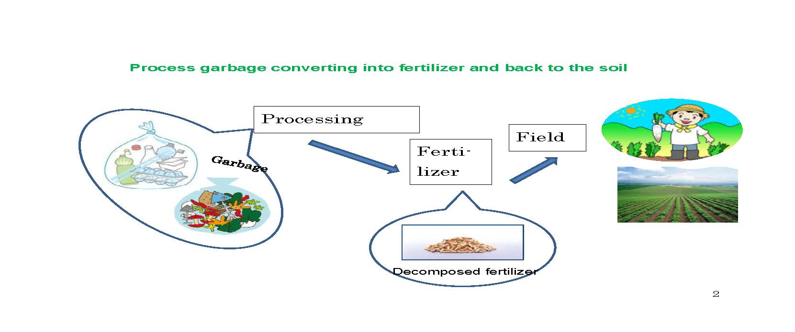

Slide 3
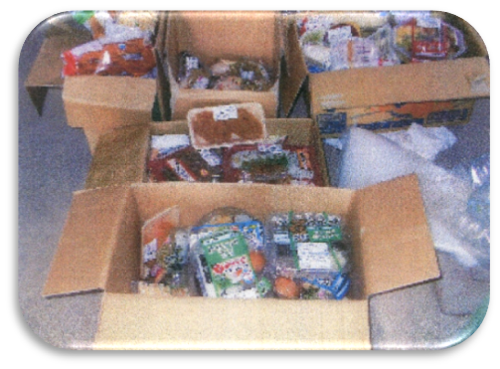
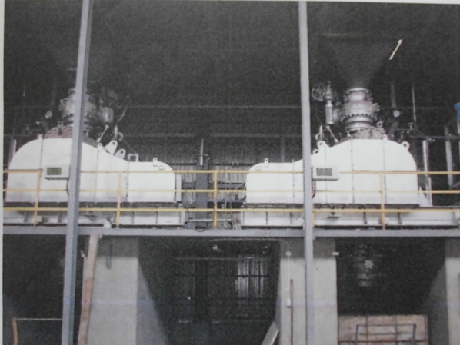
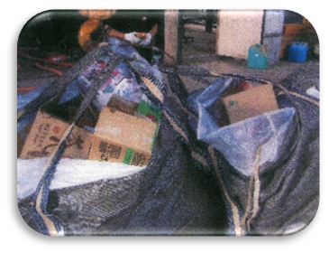
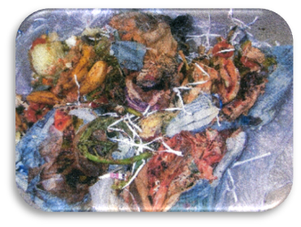
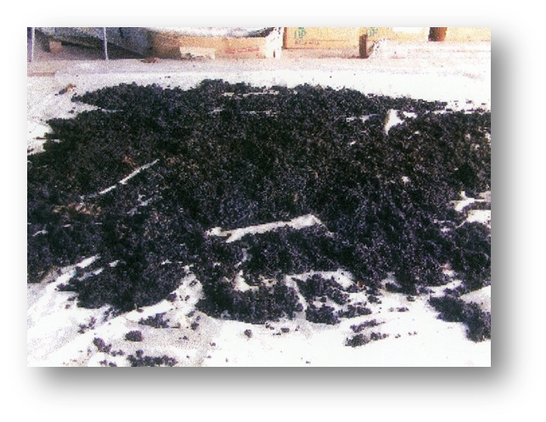
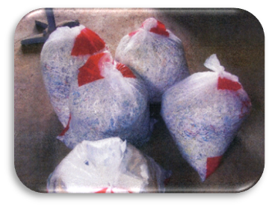
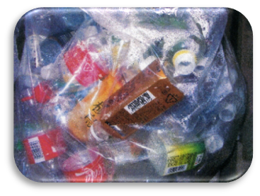

Slide 4
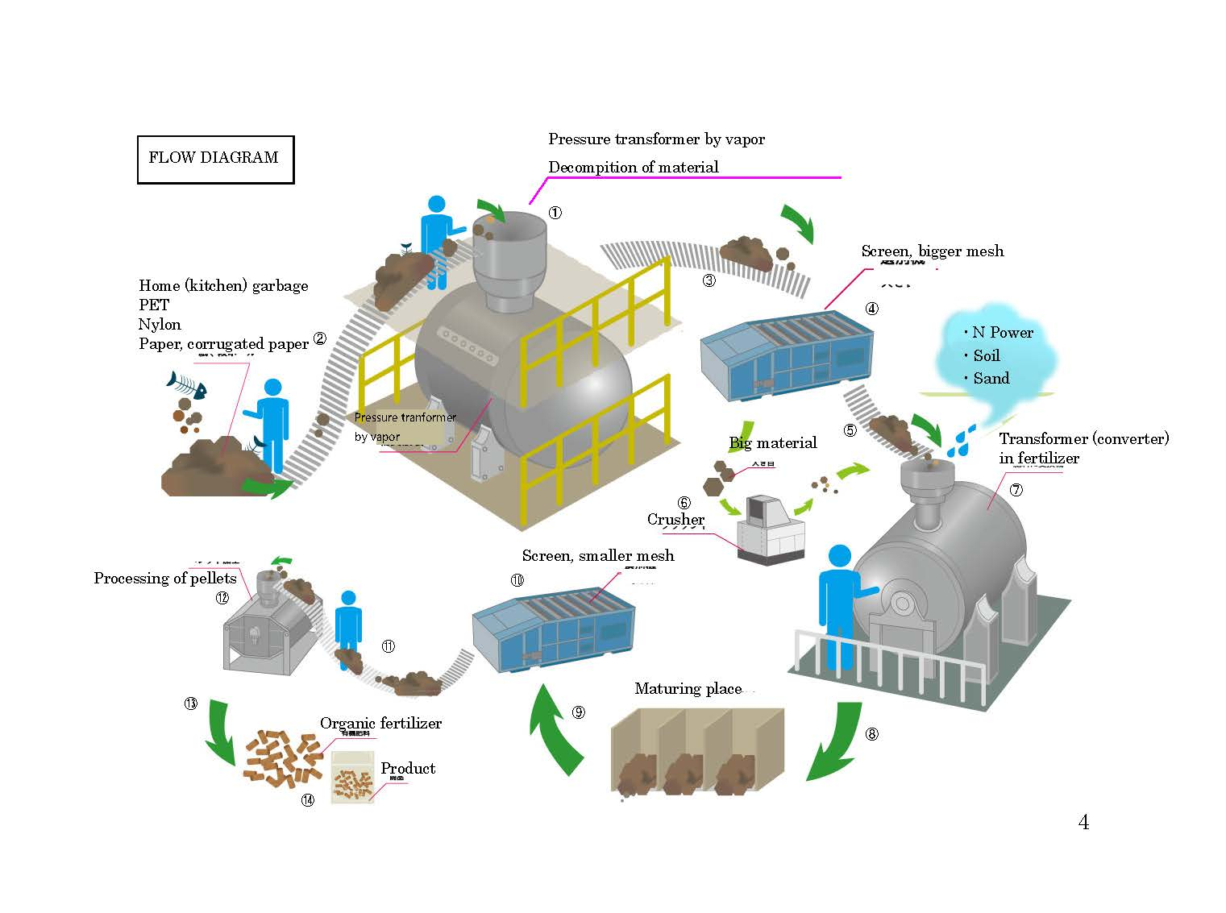

Slide 5
Pressure tranformer by vapor (original)
High pressure boiler (conventional)
Silenser (original)
Valves (conventionals)
Belt conveyor (conventional)
Belt conveyor (conventional)
Screen, bigger mesh (conventional)
Belt conveyor (conventional)
Crusher (conventional)
Convertor in fertilizer (original)
Belt conveyor (conventional)
9 Belt conveyor (conventional)
10. Screen, smaller mesh (conventional)
11 Belt coneyor (conventional)
12 Processer of pellets (conventional)

Slide 6
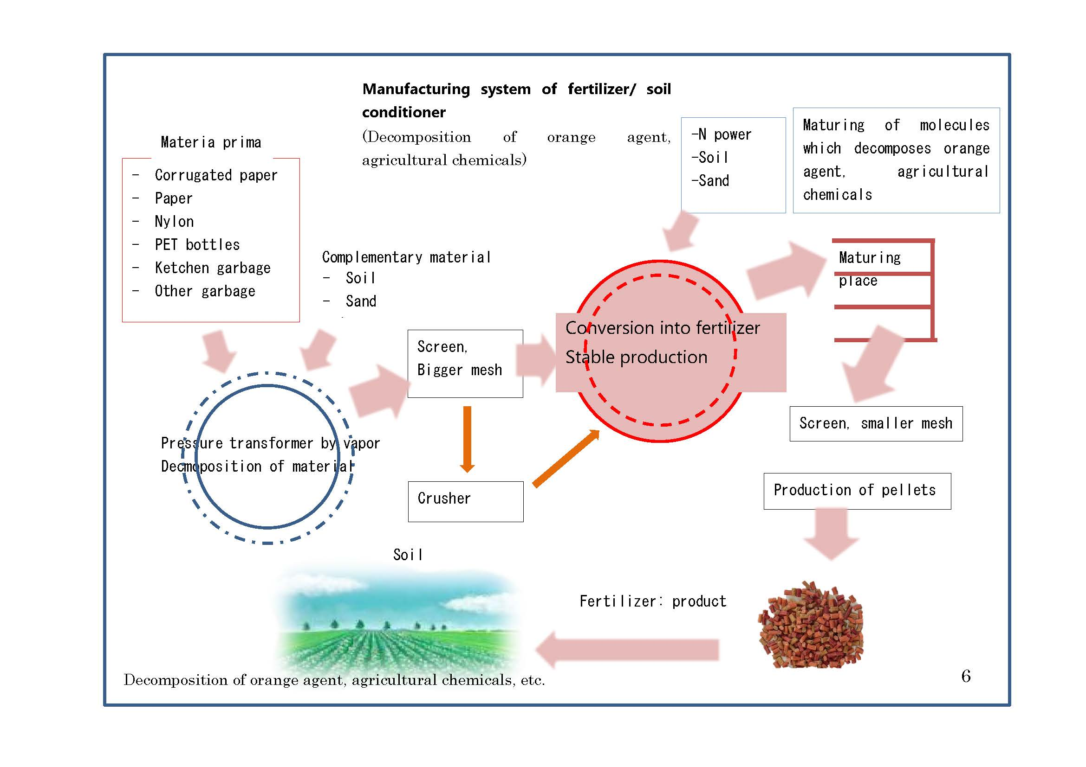

Slide 8
